Slide 1

Random Variables and Probability Distributions
From Outcomes to Real Numbers

Slide 2
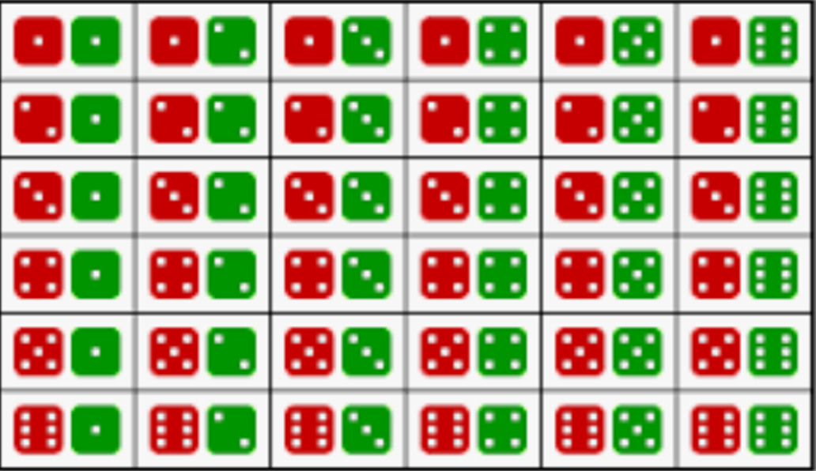
Revisit Dice Rolling Example
 | 2 | 3 | 4 | 5 | 6 | 7 | 8 | 9 | 10 | 11 | 12
prob | 1/36 | 2/36 | 3/36 | 4/36 | 5/36 | 6/36 | 5/36 | 4/36 | 3/36 | 2/36 | 1/36
Define a new variable: The sum of the dots facing upward when rolling two dice.
Let’s call this variable X.
Thus, X= the sum of dots facing upward when rolling two dice.

Slide 3
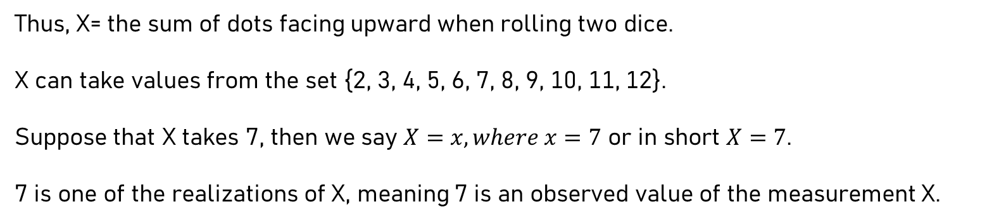
Random Variable
2, 3, 4, 5,
6, 7, 8, 9,
10, 11, 12
Range
Domain
X
X is called a Random Variable.
Thus, X= the sum of dots facing upward when rolling two dice.
X can take values from the set {2, 3, 4, 5, 6, 7, 8, 9, 10, 11, 12}.
Suppose that X takes 7, then we say $X=x, where x=7$ or in short $X=7$.
7 is one of the realizations of X, meaning 7 is an observed value of the measurement X.

Slide 4
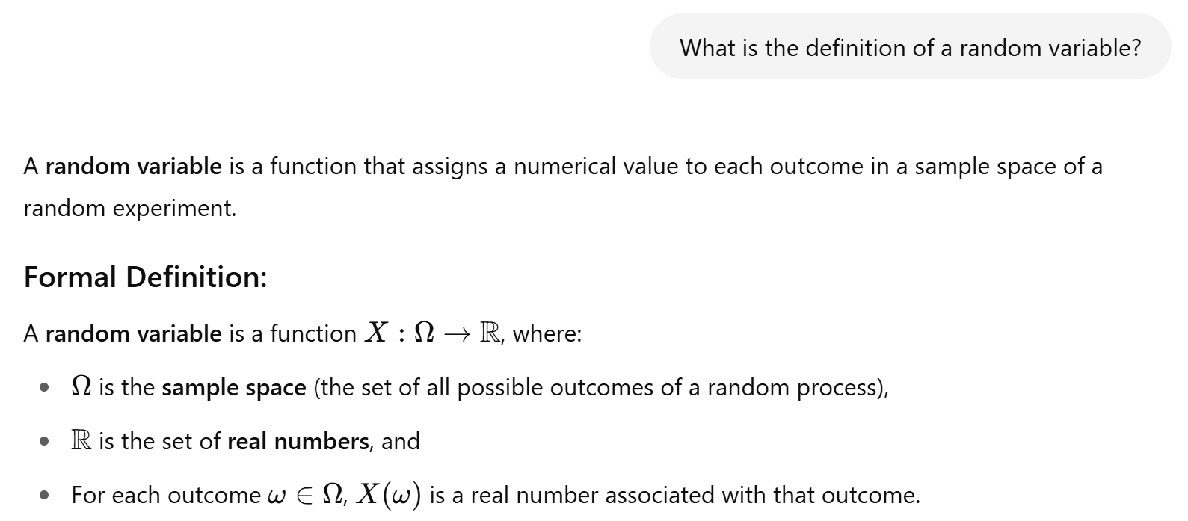

Slide 5
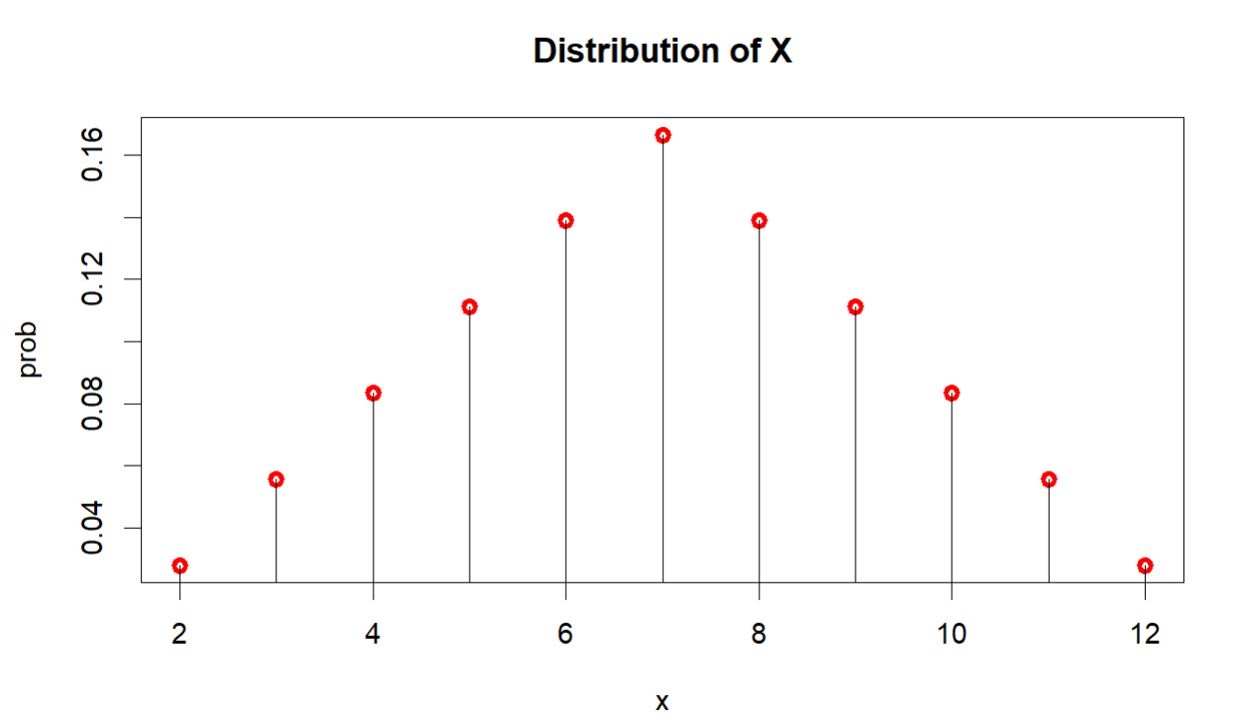
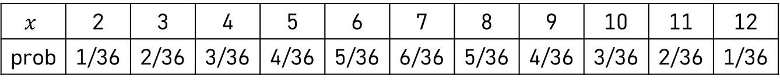

The Distribution of a Random Variable
$$x$$ | 2 | 3 | 4 | 5 | 6 | 7 | 8 | 9 | 10 | 11 | 12
prob | 1/36 | 2/36 | 3/36 | 4/36 | 5/36 | 6/36 | 5/36 | 4/36 | 3/36 | 2/36 | 1/36
$$prob=p\left(x\right)=\left\{\begin{matrix}\begin{matrix}\frac{1}{36}, x=2,12 \\ \frac{2}{36}, x=3,11 \\ \frac{3}{36}, x=4, 10\end{matrix} \\ \begin{matrix}\frac{4}{36}, x=5, 9 \\ \frac{5}{36}, x=6, 8 \\ \frac{6}{36}, x=7 \end{matrix} \\ 0, Otherwise\end{matrix}\right.$$

Slide 6
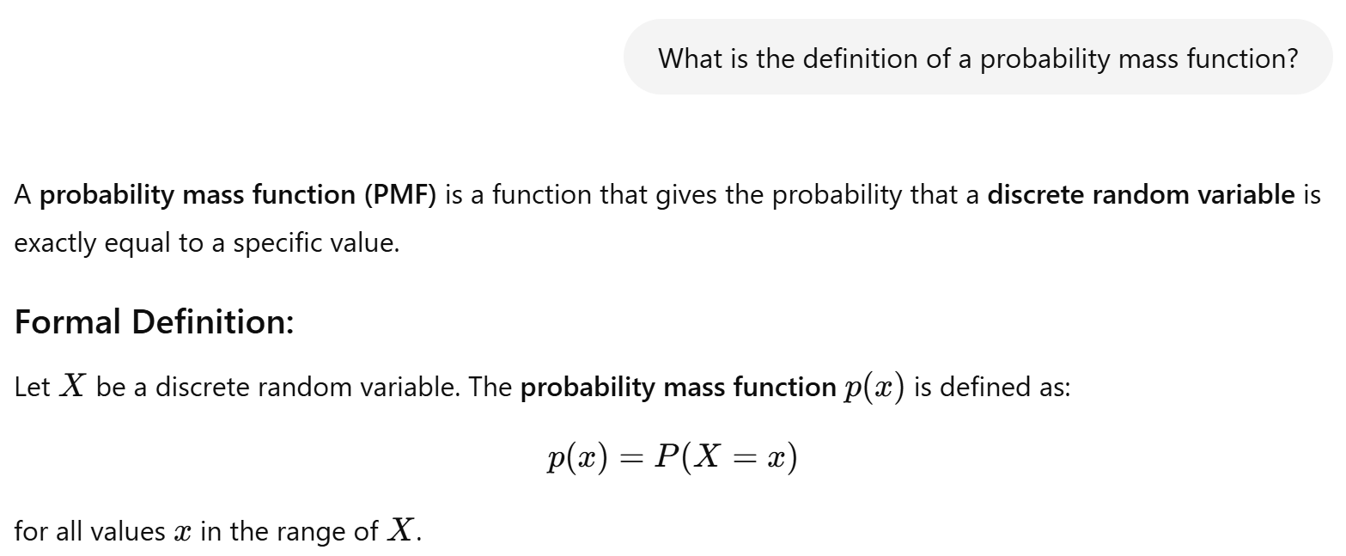

Probability Mass Function
$$prob=p\left(x\right)=\left\{\begin{matrix}\begin{matrix}\frac{1}{36}, x=2,12 \\ \frac{2}{36}, x=3,11 \\ \frac{3}{36}, x=4, 10\end{matrix} \\ \begin{matrix}\frac{4}{36}, x=5, 9 \\ \frac{5}{36}, x=6, 8 \\ \frac{6}{36}, x=7 \end{matrix} \\ 0, Otherwise\end{matrix}\right.$$

Slide 7
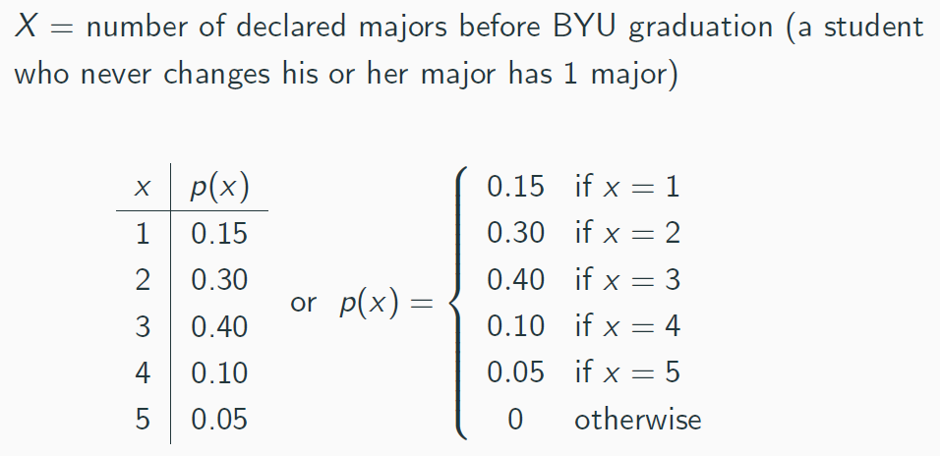

Example:
X is a discrete random variable.
The distribution of X is discrete.
The p.m.f. of X is given as p(x), where
$$p\left(x\right)=P\left(X=x\right).$$

Slide 8
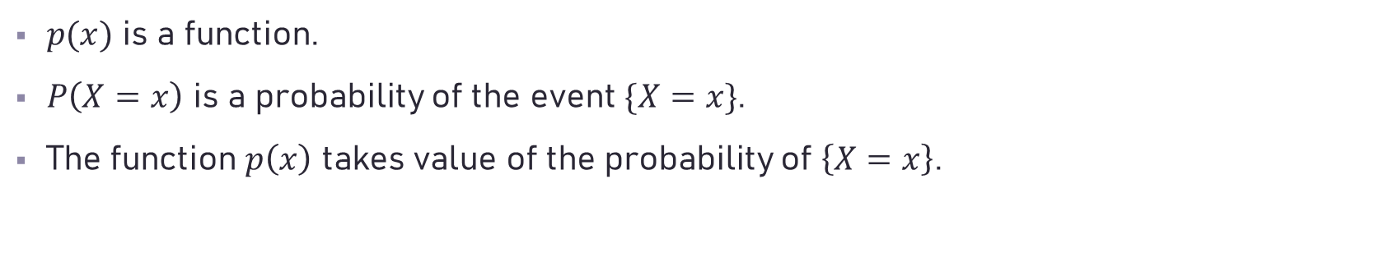
Remarks
$p(x)$ is a function.
$P\left(X=x\right)$ is a probability of the event $\{X=x\}$.
The function $p\left(x\right)$ takes value of the probability of $\left\{X=x\right\}$.

Slide 9

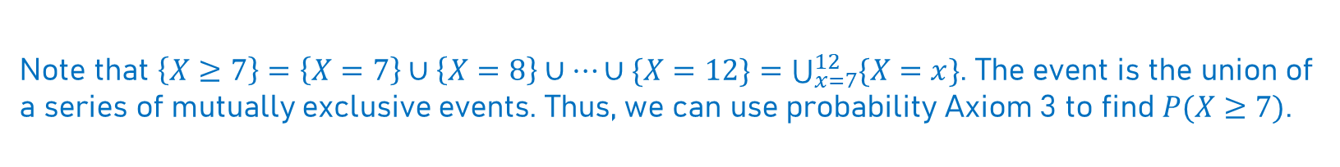
Example: Rolling Dice
$$x$$ | 2 | 3 | 4 | 5 | 6 | 7 | 8 | 9 | 10 | 11 | 12
prob | 1/36 | 2/36 | 3/36 | 4/36 | 5/36 | 6/36 | 5/36 | 4/36 | 3/36 | 2/36 | 1/36
$$P\left(X≥7\right)=p\left(7\right)+p\left(8\right)+…+p\left(12\right)=\sum_{x=7}^{12}{p(x)}$$
Note that $\left\{X≥7\right\}=\left\{X=7\right\}∪\left\{X=8\right\}∪…∪\{X=12\}=\bigcup_{x=7}^{12}{\{X=x\}}$. The event is the union of a series of mutually exclusive events. Thus, we can use probability Axiom 3 to find $P(X≥7)$.

Slide 10
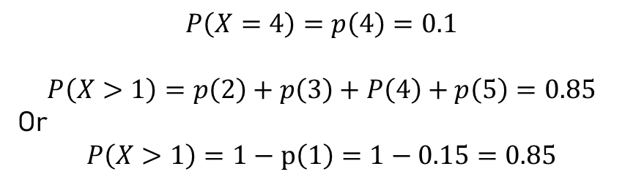
Example:
$$P\left(X=4\right)=p\left(4\right)=0.1$$
$$P\left(X>1\right)=p\left(2\right)+p\left(3\right)+P\left(4\right)+p\left(5\right)=0.85$$
Or
$$P\left(X>1\right)=1−p\left(1\right)=1−0.15=0.85$$

Slide 11
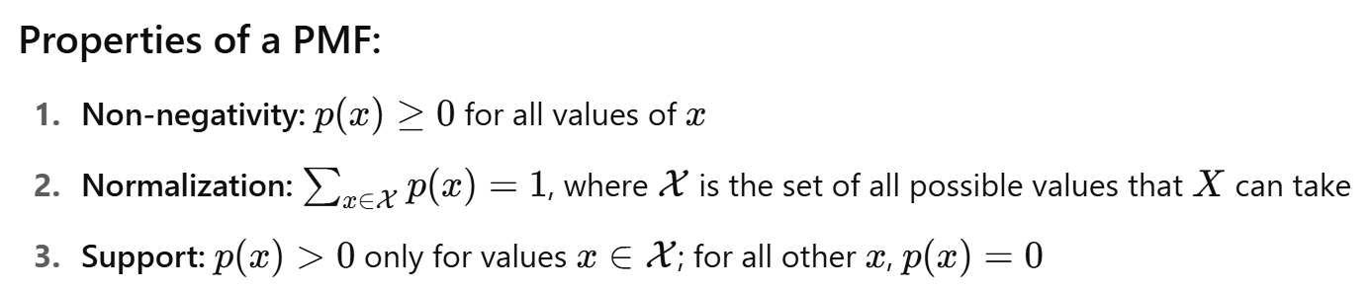

Slide 12

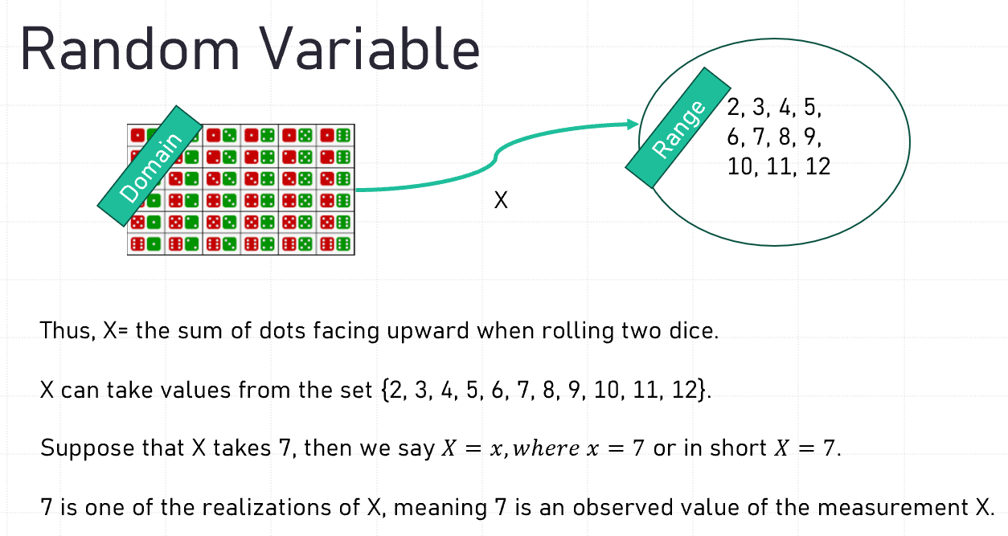

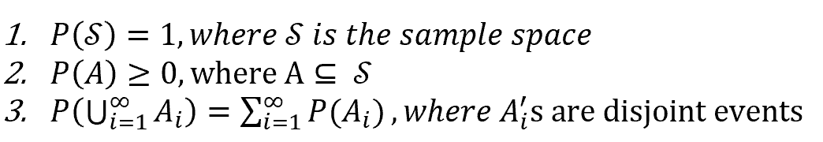
Notes

Slide 13
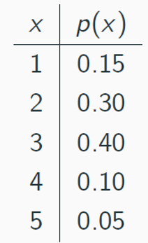
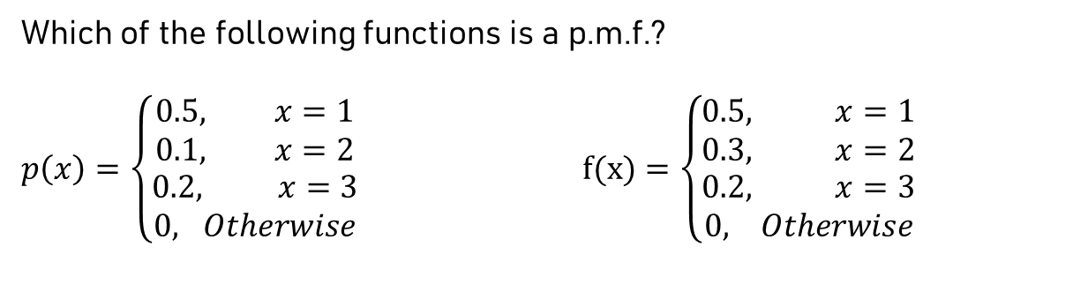
Verifying PMF Properties
(a)
$$x$$ | 2 | 3 | 4 | 5 | 6 | 7 | 8 | 9 | 10 | 11 | 12
prob | 1/36 | 2/36 | 3/36 | 4/36 | 5/36 | 6/36 | 5/36 | 4/36 | 3/36 | 2/36 | 1/36
(c)
Which of the following functions is a p.m.f.?
$p\left(x\right)=\left\{\begin{aligned}0.5, x=1 \\ 0.1, x=2 \\ \begin{matrix}0.2, x=3 \\ 0, Otherwise\end{matrix}\end{aligned}\right.$ $f(x)=\left\{\begin{aligned}0.5, x=1 \\ 0.3, x=2 \\ \begin{matrix}0.2, x=3 \\ 0, Otherwise\end{matrix}\end{aligned}\right.$
(b)

Slide 14
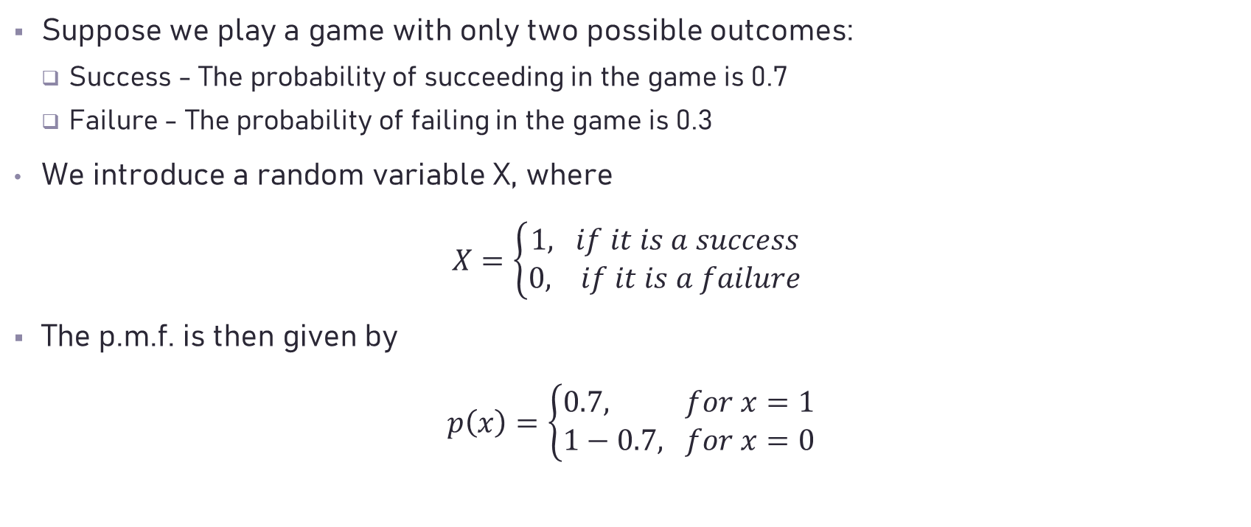
Example: Binary Outcomes
Suppose we play a game with only two possible outcomes:
Success - The probability of succeeding in the game is 0.7
Failure - The probability of failing in the game is 0.3
We introduce a random variable X, where
$X=\left\{\begin{aligned}1, if it is a success \\ 0, if it is a failure\end{aligned}\right.$
The p.m.f. is then given by
$p\left(x\right)=\left\{\begin{aligned}0.7, for x=1 \\ 1−0.7, for x=0\end{aligned}\right.$

Slide 15
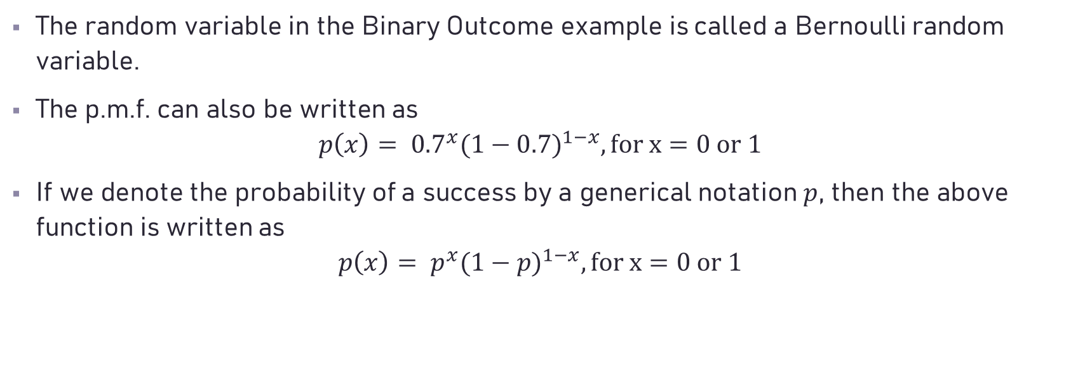
Remarks
The random variable in the Binary Outcome example is called a Bernoulli random variable.
The p.m.f. can also be written as
$$p\left(x\right)= {0.7}^{x}{(1−0.7)}^{1−x}, for x=0 or 1$$
If we denote the probability of a success by a generical notation $p$, then the above function is written as
$$p\left(x\right)= p^{x}{(1−p)}^{1−x}, for x=0 or 1$$

Slide 16
Bernoulli Distribution
The random variable in the Binary Outcome example is called a Bernoulli random variable.

